Slide 1


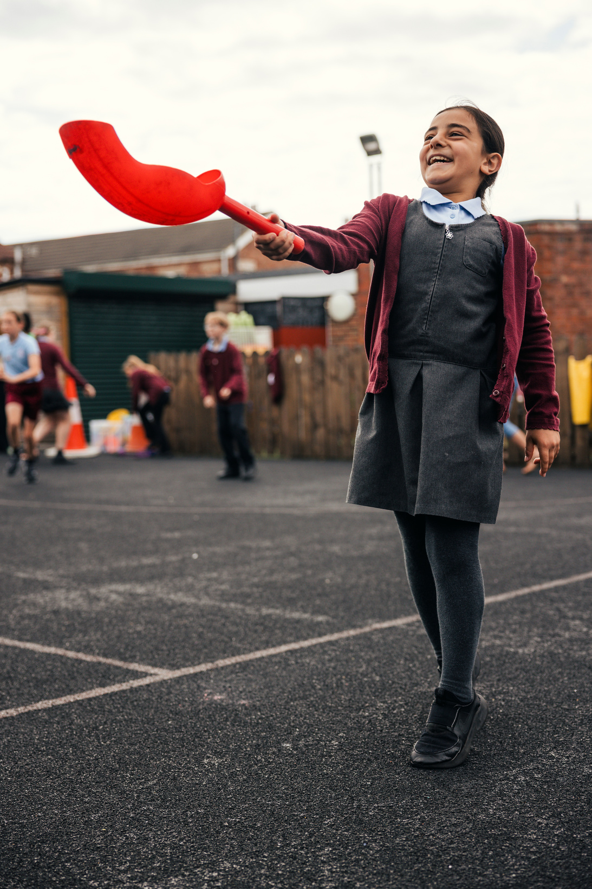


Part A
PE and Sport Premium transition toolkit
Monitoring form
2026/27 academic year

Slide 2
Part A PE and sport premium transition toolkit
Monitoring form
It is intended that this monitoring form should be used as preparation for the completion of the statutory DfE PE and sport premium digital expenditure reporting return. You can upload data (including swimming) from this template onto this platform once it becomes accessible.
The template is a working document that you can amend and up during the year.
Before you decide how you are going to use the funding for this academic year you should reflect and evaluate the impact of your use of your PE and sport premium funding in 2026/27.
You should use your evaluation of last year’s funding to help you decide what to do this academic year, how you will do it, and what impact you expect it to have.
All spending of the funding must conform with the terms outlined in the conditions of grant
The summative digital expenditure reporting form includes swimming and water safety information. PE and sport premium funding can be used to provide top-up lessons following the completion of core-swimming lessons where necessary, to ensure pupils meet national curriculum swimming requirements
To ensure funding is used effectively and based on your school’s needs; guidance and examples of best practice across schools can be found here.
You must use the funding to make additional and sustainable improvements to the PE and sport in your school.
You must develop and add to the PESSPA activities that your school already offers.
Useful Links:
PE and sport premium for primary schools - GOV.UK
PE and sport premium: conditions of grant 2026 to 2027 - GOV.UK
The grant also supports the Inclusion 2024 Inclusive PE hub an online platform of resources to help schools make PE and sport more inclusive.
Swimming and Water Safety

Slide 3
Review of the last academic year (2025/2026)
Example data is for reference only:
Take some time to reflect on your intent, implementation and impact from last academic year to celebrate your wins but to also think about improvements for the year ahead.
You do not need to complete every box. Just record the information that is key to your school's priorities and areas of focus.
Remember - Be clear about how you focused spending on key groups such as SEND, girls and disadvantaged pupils.
Swimming and Water Safety | What went well? Supporting evidence? | What didn't go well? Supporting evidence?
1. Swim competently, confidently and proficiently over a distance of at least 25 metres | 93% of pupils in year 6 can swim 25 metres. Evidenced on Swimming assessment tracker based on information and data collected poolside with swimming teacher. | We are aiming for this to be 100%,. Evidenced on Swimming assessment tracker based on information and data collected poolside with swimming teacher.
2. Use a range of strokes effectively (for example, front crawl, backstroke and breaststroke) | 93% of pupils in year 6 can use a range of strokes effectively. Evidenced on Swimming assessment tracker based on information and data collected poolside with swimming teacher. | We are aiming for this to be 100%,. Evidenced on Swimming assessment tracker based on information and data collected poolside with swimming teacher.
3. Perform safe self-rescue in different water-based situations | 93% of pupils in year 6 can perform safe self-rescue. Evidenced on Swimming assessment tracker based on information and data collected poolside with swimming teacher. | We are aiming for this to be 100%,. Evidenced on Swimming assessment tracker based on information and data collected poolside with swimming teacher.

Slide 4
Review of the last academic year (2025/2026)
Example data is for reference only:
Key areas as outlined in PE and sport premium guidance | What went well? Supporting evidence? | What didn't go well? Supporting evidence?
1. Increase all staff’s confidence, knowledge and skills in teaching PE and sporting activities | Staff confidence, knowledge and skills in teaching PE and sporting activities have improved across the school. The introduction of a purchased PE curriculum has provided teachers with clear progression, high-quality lesson resources and greater confidence in delivering PE lessons. Specialist sports coaches have worked alongside staff through team teaching and modelling effective practice, enabling teachers to develop their subject knowledge and teaching skills. As a result, the quality and consistency of PE provision has increased | It’s great that 80% of staff now feel confident to enjoy delivering high-quality Physical Education but we need this to apply to all staff. See staff confidence and lesson observation data in first column. Staff Professional Development Plans indicate the gaps that remain in confidence.
2. Increase all pupils’ engagement in regular physical activity and sporting activities | Pupil engagement in regular physical activity and sporting activities increased significantly through our membership of the Shenfield Sports Partnership. Throughout the year, pupils participated in a wide range of sporting events and festivals, including opportunities specifically designed to encourage participation from girls, boys and pupils with SEND. Our focus was on providing inclusive experiences and increasing participation rather than selecting only the most able athletes. Disadvantaged pupils were actively encouraged and supported to attend events, ensuring equitable access to sporting opportunities. As a result, a greater number of pupils engaged in competitive and non-competitive sport, developed confidence and resilience, and experienced the benefits of representing the school in a variety of physical activities. | Not all pupils are active for 60 minutes a day, 7 days a week. There are still 30% of our pupils that are not active for 60 minutes a day, 7 days a week based on data captured linked to in and outside of school physical activity. Only 25% of FS/KS1 and 30% of KS2 attended extra-curricular clubs at school.

Slide 5
Review of the last academic year (2025/2026)
Key areas as outlined in PE and sport premium guidance | What went well? Supporting evidence? | What didn't go well? Supporting evidence?
3. Raising the profile of PE and sport across the school, to support whole school improvement | The profile of PE and sport has been raised across the school through increased participation in competitions, festivals and sporting events. Membership of the Shenfield Sports Partnership provided a broad range of opportunities for pupils to represent the school and celebrate sporting achievement. Successes and participation were shared through assemblies, newsletters and school communications, helping to promote positive attitudes towards physical activity. PE and sport have become an integral part of school life, supporting pupil wellbeing, confidence, teamwork and resilience. The increased visibility of sporting opportunities has encouraged more pupils to engage in physical activity and contributed positively to the wider aims of school improvement. | Staffing availability and competing school priorities occasionally limited the number of events and clubs that could be offered. There were also challenges in ensuring that all pupils could attend every event due to transport, timing and capacity restrictions.
4. Increase participation in competitive sport | Participation in competitive sport increased significantly during the year. The appointment of a new sports coach, alongside the use of external sports coaches, enabled the school to attend a wider range of competitive sporting events and festivals. Pupils benefited from targeted training and preparation prior to competitions, improving both their skills and confidence. As a result, more pupils had the opportunity to represent the school in competitive sport, leading to increased participation, enhanced sporting experiences and greater success at inter-school events. | Continue to develop our competition provision. More KS1 children need to have experience of competitive sports Sports coach started in January. Competitive sorts was lacking in autumn term due to staffing issues.
5. Increase extra curricular opportunities an school and encourage pupils to be outside and active | Extra-curricular opportunities were expanded significantly, encouraging pupils to be more active and spend more time outdoors. Forest School sessions were provided for all pupils, with additional targeted provision for SEND pupils and nurture groups to support their physical, social and emotional development. Active playtimes were promoted across the school, helping pupils to increase their daily levels of physical activity. A wide range of after-school clubs was also offered, providing opportunities for pupils of all ages and abilities to participate in regular physical activity. | Need to ensure all disadvantage pupils engage in sporting clubs outside school if they want to.

Slide 6
What are your next steps for this 2026/27 academic year?
Aim | Why? | Key Area | Supporting evidence
Provide in school opportunities for pupils to access multiple opportunities to be physically active and monitor external physical activity to drive physical activity levels with key focus groups. | To ensure that 100% of pupils will be active on average 60 minutes a day, 7 days a week. | Key Indicator 2: Increasing engagement of all pupils in regular physical activity and sporting activities | External physical activity trackers outlining the amount of activity pupils' access outside of school. Extra curricular timetable and participation data. Lunchtime participation data, alongside lunchtime activity plan.
Provide regular intra school competition, as well as all pupils accessing inter competitions against other schools. Competition formats to reflect needs of pupils. See school games offer | To ensure 100% of pupils can access competition in school and outside of school, to encourage all pupils to participate and enjoy these valuable experiences. | Key indicator 5: Increasing participation in competitive sport | Competition formats and planning for all intra lesson level competitions, all inter competitions hosted at our school and sports day. Competition calendar and register of participants.
Focus on top-up swimming and water safety for those pupils not achieving the expected swimming and water safety attainment. | To ensure 100% of pupils meet the expected swimming targets. | Key Indicators 1, 3, 4. Developing pupil attainment. | Evidenced on Swimming assessment tracker based on information and data collected poolside with swimming teacher.
Enhance pupils' physical activity, wellbeing and engagement through provision to develop their fundamental movement skills, resilience, teamwork and confidence. | Regular access to time outdoors. To ensure physical activity contributes to wellbeing activities. Positive attitudes towards lifelong participation in healthy, active lifestyles | Key Indicator 2: | Forest School sessions Observations form teacher and FS leader.

Slide 7
PE and school sport checklist
Consider within your school where you currently stand and what further support you need to put in place.
Questions | Yes | Partly | No
Do you have a clear PE and school sport action plan for the year ahead (2026/27), agreed by leadership? | X
Can you evidence how last year’s PE and sport premium funding was spent, and what difference it made? | X
Do you know what Physical Education looks and feels like in your school and is this delivery high-quality? | X
Is there a clear plan to develop staff confidence in PE, whether delivery is internal, external or mixed? | X
Do you have a curriculum that is broad, progressive and properly sequenced across year groups? | X
Do you know how many pupils are active for at least 60 minutes a day, 7 days a week? |  | X
Do you have a clear plan for your extra-curricular club offer? | X
Is your wider school sport offer, including competitions, festivals, and fixtures planned? | X
Do you have effective data collection systems in place to record and evidence that swimming and water safety provision is on track to meet national curriculum requirements ? |  | X
Do you have a clear plan for encouraging SEND pupils and less active pupils to become more active and participate in PE and school sport? | X
If a governor, trust lead or external reviewer asked to see your PE and sport plan for future development, would you have clear evidence and rationale for impact? | X
Are you clear on existing links with local clubs, and community settings to identify where further support and engagement could be made using local support for enhance your provision? | X

Slide 8
Aims for the next academic year (2026/2027)
Using your whole school priorities, school development plan and previous PE, school sport and physical activity data, set out your aims for the year ahead.
Think about specific areas of need such as inactive girls, SEND and disadvantaged pupils
Remember to also input your swimming data and reflections in the table located at the bottom of this page.
Consider which of the 5 key areas improvements will be focusing on:
increase all staff’s confidence, knowledge and skills in teaching PE and sporting activities
increase all pupils’ engagement in regular physical activity and sporting activities
raise the profile of PE and sport across the school, to support whole school improvement
offer a broader and more equal experience of a range of sports and physical activities to all pupils, and ensure equal access to sport for boys and girls
increase participation in competitive sport
Please aim to use this as a live working document through the year.
Keep returning to this to evidence adaptations and progress made through the PESSPA opportunities you provide.
There is no set number of objectives you must have.
Make as many or as few as you see fit that will support your aims for the year ahead

Slide 9
Plan, monitor and evaluate (2026/2027)
Questions | Yes | Partly | No
Do you have effective data collection systems in place to record and evidence that swimming and water safety provision is on track to meet national curriculum requirements ? |  | x
Will any of your year 6 group be accessing top up swimming to enable them to achieve the outcomes below? | x
Look at the attainment of your current year 6 cohort. Complete by July 31, 2027.
Swimming and Water Safety | What went well? Supporting evidence? | What didn't go well? Supporting evidence?
1. Swim competently, confidently and proficiently over a distance of at least 25 metres | 93% of pupils in year 6 can swim 25 metres. This was down to including top-up swimming sessions for those pupils falling under the required attainment. Evidenced on Swimming assessment tracker based on information and data collected poolside with swimming teacher. | We are aiming for this to be 100%. Evidenced on Swimming assessment tracker based on information and data collected poolside with swimming teacher.
2. Use a range of strokes effectively (for example, front crawl, backstroke and breaststroke) | 93% of pupils in year 6 can use a range of strokes effectively. This was down to including top up swimming sessions for those pupils falling under the required attainment. Evidenced on Swimming assessment tracker based on information and data collected poolside with swimming teacher. | We are aiming for this to be 100%. Evidenced on Swimming assessment tracker based on information and data collected poolside with swimming teacher.
3. Perform safe self-rescue in different water-based situations | 93% of pupils in year 6 can perform safe self rescues. This was down to including top up swimming sessions for those pupils falling under the required attainment. Evidenced on Swimming assessment tracker based on information and data collected poolside with swimming teacher. | We are aiming for this to be 100%. Evidenced on Swimming assessment tracker based on information and data collected poolside with swimming teacher.

Slide 10
Plan, monitor and evaluate (2026/2027)
 | Intent - what is your objective? | Implementation - How will you achieve this? | Impact - What do you hope to see? | Supporting evidence
Plan and monitor (Complete now and monitor) | Provide in school opportunities for pupils to access multiple opportunities to be physically active and monitor external physical activity to drive physical activity levels with key focus groups. | Provide a wide range of lunchtime, after-school and Forest School activities to encourage regular participation in physical activity. Develop opportunities for active learning outdoors through Forest School sessions, incorporating physical challenges, team-building activities and adventurous play. Target key groups of pupils, including less active children, SEND pupils and disadvantaged pupils, to ensure equitable access to physical activity opportunities. Increase participation in extracurricular sports clubs, festivals and competitions both within school and across the local area. Promote active playtimes through the provision of equipment, playground leaders and structured activities. | Monitor pupil participation in both school-based and external physical activities through surveys, club registers and pupil voice. Use participation data to identify pupils with lower activity levels and provide tailored opportunities to increase engagement. . Engage parents and carers in promoting healthy, active lifestyles beyond the school day. Regularly evaluate the impact of activities and adapt provision to maximise participation and sustain increased physical activity levels. Pupil voice data will show key groups have taken multiple opportunities in school to be active. | Staff confidence surveys, pupils' attainment data, lesson observation reviews, pupil voice.
 | What impact have you seen? |  | Supporting evidence | Approx. cost
Evaluate (to be completed by July 2027)

Slide 11
Plan, monitor and evaluate (2026/2027)
 | Intent - what is your objective? | Implementation - How will you achieve this? | Impact - What do you hope to see? | Supporting evidence
Plan and monitor (Complete now and monitor) | Provide regular intra school competition, as well as all pupils accessing inter competitions against other schools. Competition formats to reflect needs of pupils. See school games offer | Increase the number and range of activities and clubs on offer (Pupil Led Games, dodgeball, games, dance. Parent and child fitness club.) Implementation of new extra-curricular timetable. Develop provision for physical activity at lunchtime by; Increasing the amount of playground resources to provide playground activity facilitated by lunchtime supervisors and year 6 playleaders. Equipment and resources to be purchased for facilitation of activity with playleaders and independent active play. Use leadership ideas from scheme of work. | In July 2026, only 70% of the school were active for 60 minutes a day, 7 days a week. We aim to drive this to 100% by July 2027 through the addition of new lunch and extra curricular opportunities. In July 2026, across the school 65% of pupils participated in activity at lunchtime. We are aiming for 90% of pupils to be active at lunchtime through new play-leader activities and lunchtime clubs. In July 2026 KS1 and KS2 participation in extra curricular clubs both sat at 47% . By July 2027, we predict this to increase to 75% through the addition of new clubs. | External physical activity trackers outlining the amount of activity pupils’ access outside of school. Extra curricular timetable and participation data. Lunchtime participation data, alongside lunchtime activity plan. Data for all physical activity level tracked on scheme of work PA assessment.
 | What impact have you seen? | Are the improvements sustainable? | Supporting evidence | Approx. cost
Evaluate (to be completed by July 2027) | In July 2026, only 70% of the school were active for 60 minutes a day, 7 days a week. Now in July 2027 through the addition of new lunch and extra curricular opportunities, 100% of the school were active for 60 minutes a day, 7 days a week In July 2026, across the school 65% of pupils participated in activities at lunchtime. Now in July 2027, 90% of pupils are active at lunchtime through new play-leader activities and lunchtime clubs. In July 2026 KS1 and KS2 participation in extra curricular clubs both sat at 47%. Now in July 2027, 75% of all pupils participate in extra curricular clubs. | Now they are trained, MDS to continue to provide the training to the next cohort of year 6 playleaders to support sustainability. Continue to provide high-quality extra-curricular clubs that are parent paid and therefore do not require any funding or teacher led and so free to attend. | External physical activity trackers outlining the amount of activity pupils’ access outside of school. Extra curricular timetable and participation data. Lunchtime participation data, alongside lunchtime activity plan. Data for all physical activity level tracked on scheme of work’s PA assessment. | £450 new equipment for extra curricular clubs. £550 new equipment for lunchtimes. Total = £1000

Slide 12
Plan, monitor and evaluate (2026/2027)
 | Intent - what is your objective? | Implementation - How will you achieve this? | Impact - What do you hope to see? | Supporting evidence
Plan and monitor (Complete now and monitor) | Enhance pupils' physical activity, wellbeing and engagement through provision to develop their fundamental movement skills, resilience, teamwork and confidence. | Through the delivery of high-quality PE lessons, Forest School provision and active playtimes, pupils will have regular opportunities to develop their fundamental movement skills and increase their physical activity levels. A broad range of inclusive extra-curricular clubs and sporting opportunities will encourage participation from all pupils, including those with SEND and disadvantaged pupils. Staff will promote teamwork, resilience and confidence through structured physical activities, outdoor learning experiences and participation in competitive and non-competitive sports. Membership of the Shenfield Sports Partnership and the use of specialist sports coaches will further enhance pupils' engagement, skill development and enjoyment of physical activity. | Increased engagement in PE, school sport and physical activity, particularly amongst less active pupils. Greater inclusion, with SEND and disadvantaged pupils actively participating in competitive sport.
 | What impact have you seen? |  |  | Approx. cost
Evaluate (to be completed by July 2027)

Slide 13
Looking ahead and sustainability
(Example is for reference purposes only)
Intent - what is your objective and why? | Implementation - How will you achieve this? | Impact - What do you hope to see? | Potential cost? | What supporting evidence will be necessary? | Is this sustainable, or does it require a year-on-year commitment
Continue to provide CPD to ensure consistently high-quality PE lessons. | PE lead to complete Primary PE Specialism Qualification to be able to provide ongoing support and training in-house. | Continued high-quality practice, maintaining impact data evidence mentioned above. |  | Staff confidence surveys, pupil attainment data, pupil voice, learning walks, staff professional development plans. | Sustainable.
Focus on lunchtime provision to maximise the offer so all pupils can participate. | Develop further midday supervisor and play leader training to increase the variety of active opportunities accessible to all pupils at lunchtime. | Maintain the activity level at lunchtime of 90% and / or exceed these. |  | Pupil activity level, pupil voice, pupil engagement. | Sustainable.

