Slide 1

Mountnessing C of E
Primary School
Starting School

Slide 2
Welcome to our school family
Mrs Obank
Head Teacher
Mrs Cannon
Deputy Head Teacher
Mrs Alice Murray
Inclusion Leader
We are so pleased that your child is going to be joining us in September.
This PowerPoint has been created to give you some information that will support the transition into school and answer some of your questions.
If you have any questions, please do not hesitate to contact the school and we will be happy to speak to you.
You have your own page on our school website where you can find extra information too.

Slide 3

Ways to contact us in school or find out information:
Check the website www.mountnessing.essex.sch.uk
Read the weekly newsletter sent by Parentmail
Call the main office 01277 353160
Email the office admin@mountnessing.essex.sch.uk
Use www.studybugs.co.uk
Email the teacher directly
ecannon@Mountnessing.essex.sch.uk
senco@mountnessing.essex.sch.uk (Mrs Murray)
Follow us on Twitter @MountnessingSch

Slide 4

Admission Forms
It is very important that we have received your admissions forms before your child joins us. Please ensure you have got a copy of these from the school office, or downloaded them from the website, and return them to us as soon as possible.
These forms give us all the information we need about your child. If anything changes (address, phone numbers etc) whilst your child is in school with us, you must inform us straight away.
These forms allow us to know who can and can’t collect your child from school.
We must have a copy of their birth certificate too.

Slide 5

Consent
In school, we ask for your consent for many things:
Photographs,
Face paint
Food tasting
Short walks in the local area
Travel on our minibus
Tapestry
This consent lasts for the amount of time your child is in school with us. If you wish to change these, you must inform the office.

Slide 6
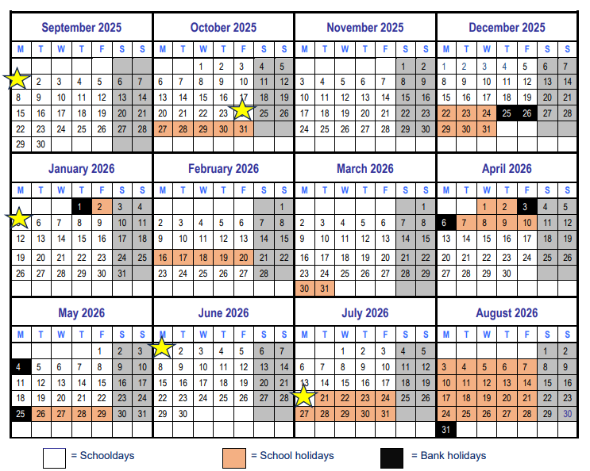
Term Dates:
The stars indicate non-pupil INSET days.
No holiday is authorised during term time.
Grey/black boxes show school holiday times and bank holidays.

Slide 7

Attendance
Attendance is vital for all children to learn, build good relationships with children and staff and feel part of the community.
We take attendance and punctuality very seriously in school and monitor it robustly.
We use Studybugs as our tool for taking registers and notifying school of absence. You must register with this website when your child starts school.
Our attendance target is 96% for all pupils.
You will be notified if your child's attendance falls below this and you may be invited in for a meeting to discuss it.
Attendance below 90% is classed as persistent absenteeism and an attendance contract will be put in place.
Leave of absence for exceptional circumstances will be considered after a form has been completed.
No holiday is authorised during term time.

Slide 8
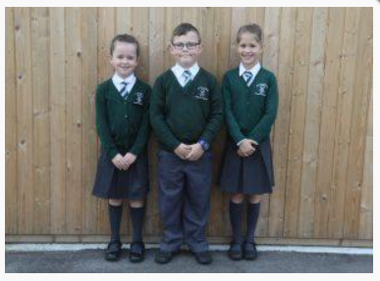
Uniform
It is our school policy that all children wear a school uniform when attending school, or when participating in school-organised events outside normal school hours.
We ask children to wear their shirts tucked into their skirts or trousers and to take pride in their appearance.
Some items of uniform can be bought from school, while others are readily available, at very competitive prices, at local shops including supermarkets.
A complete list of the items needed for school uniform including those for Physical Education is our website.
https://mountnessing-c-of-e-primary-school.secure-primarysite.net/uniform-information/

Slide 9

PARKING
Only park in actual spaces outside school
Use the George and Dragon Pub or the Windmill car park
Please slow down outside school
Use the crossing carefully

Slide 10

School Readiness
Over the summer holiday try to master some of these skills with your child.
This will help them when they start school and allow them to be independent learners.
Don't worry too much if they struggle with some of them – we will help!

Slide 11
Starting School
Below is a list of things to remember when your child starts school:
Name every item of personal belongings (clothes, coat, bottle, shoes, book bag etc)
Ensure they can do up their own shoes
Please bring in a named pair of wellies to keep at school.
Put one small key ring on their book bag to help them recognise it.
Bring a named plastic water bottle to school every day.
No toys to be brought into school
Bring in their reading diary and reading books every day.

Slide 12
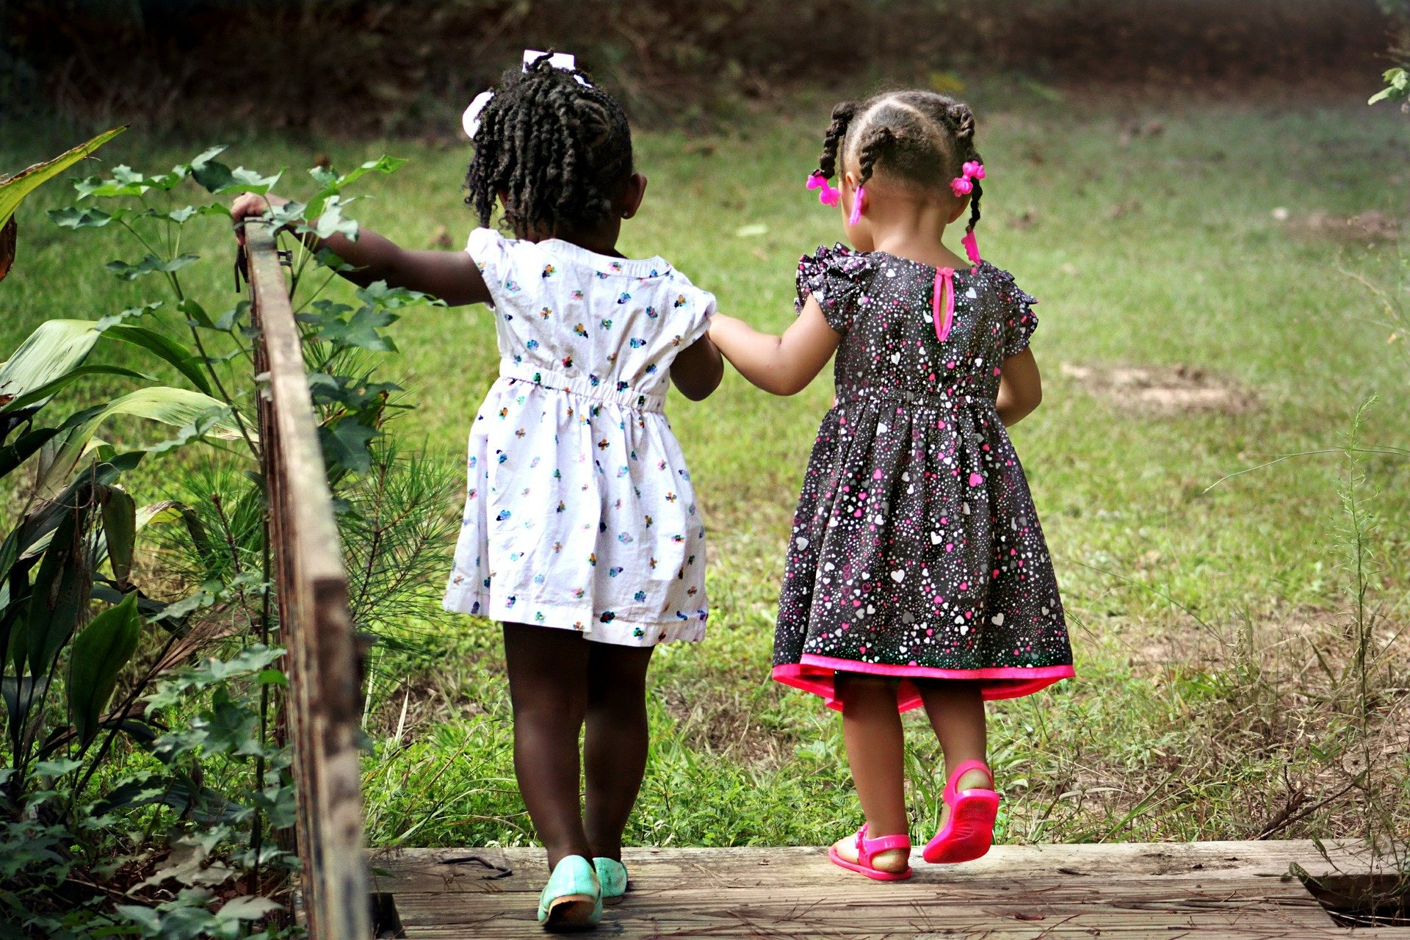
Every child deserves the best possible start in life and the support that enables them to fulfil their potential.
EYFS FRAMEWORK 21’

Slide 13









7 Areas of Learning
Expressive arts and design
Understanding the world
Literacy
EYFS
Mathematics
Personal, Social & Emotional Development
Physical development
Communication and Language

Slide 14

Over arching Principles
Unique Child: Every child is unique and has the potential to be resilient, capable, confident and self-assured.
Positive Relationships: Children flourish with warm, strong & positive partnerships between all staff and parents/carers. This promotes independence across the EYFS curriculum.
Enabling environments: Children learn and develop well in safe and secure environments where routines are established and where adults respond to their individual needs and passions and help them to build upon their learning over time.
Learning and Development: Children develop and learn at different rates We must be aware of children who need greater support than others.

Slide 15

This is all done through Play!
PLAY is essential for children’s development across all areas. Play builds on children’s confidence as they learn to explore, to relate to others around them and develop relationships ,set their own goals and solve problems. Children learn by leading their own play and by taking part in play which is guided by adults.

Slide 16
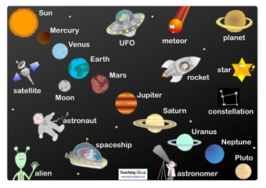



Curriculum
The 7 areas of learning are encompassed in our school curriculum.
Over the year the children will be immersed in 6 different topics:
Super Me
Space and celebrations
999 – What’s your emergency?
Once upon a time
All creatures great and small
Under the Sea

Slide 17

Phonics
In school we follow a phonics scheme called Little Wandle Letters and Sounds Revised. We have followed this scheme for 2 years now and invested heavily in booked which are matched to your child’s phonic level.
The scheme has proved successful and the children have made excellent progress.
Once your children have started school we will be arranging a parent meeting to inform you about how we teach phonics in EYFS and how you can help to support your child at home.

Slide 18

School Buddies
Your child will be given a year 5 or 6 buddy when they starts school. This helps them to know what to do at lunchtime and playtime. They will receive a letter from their buddy this term to introduce themselves.
The children will have an opportunity to meet their buddy in person once they are settled at school.

Slide 19
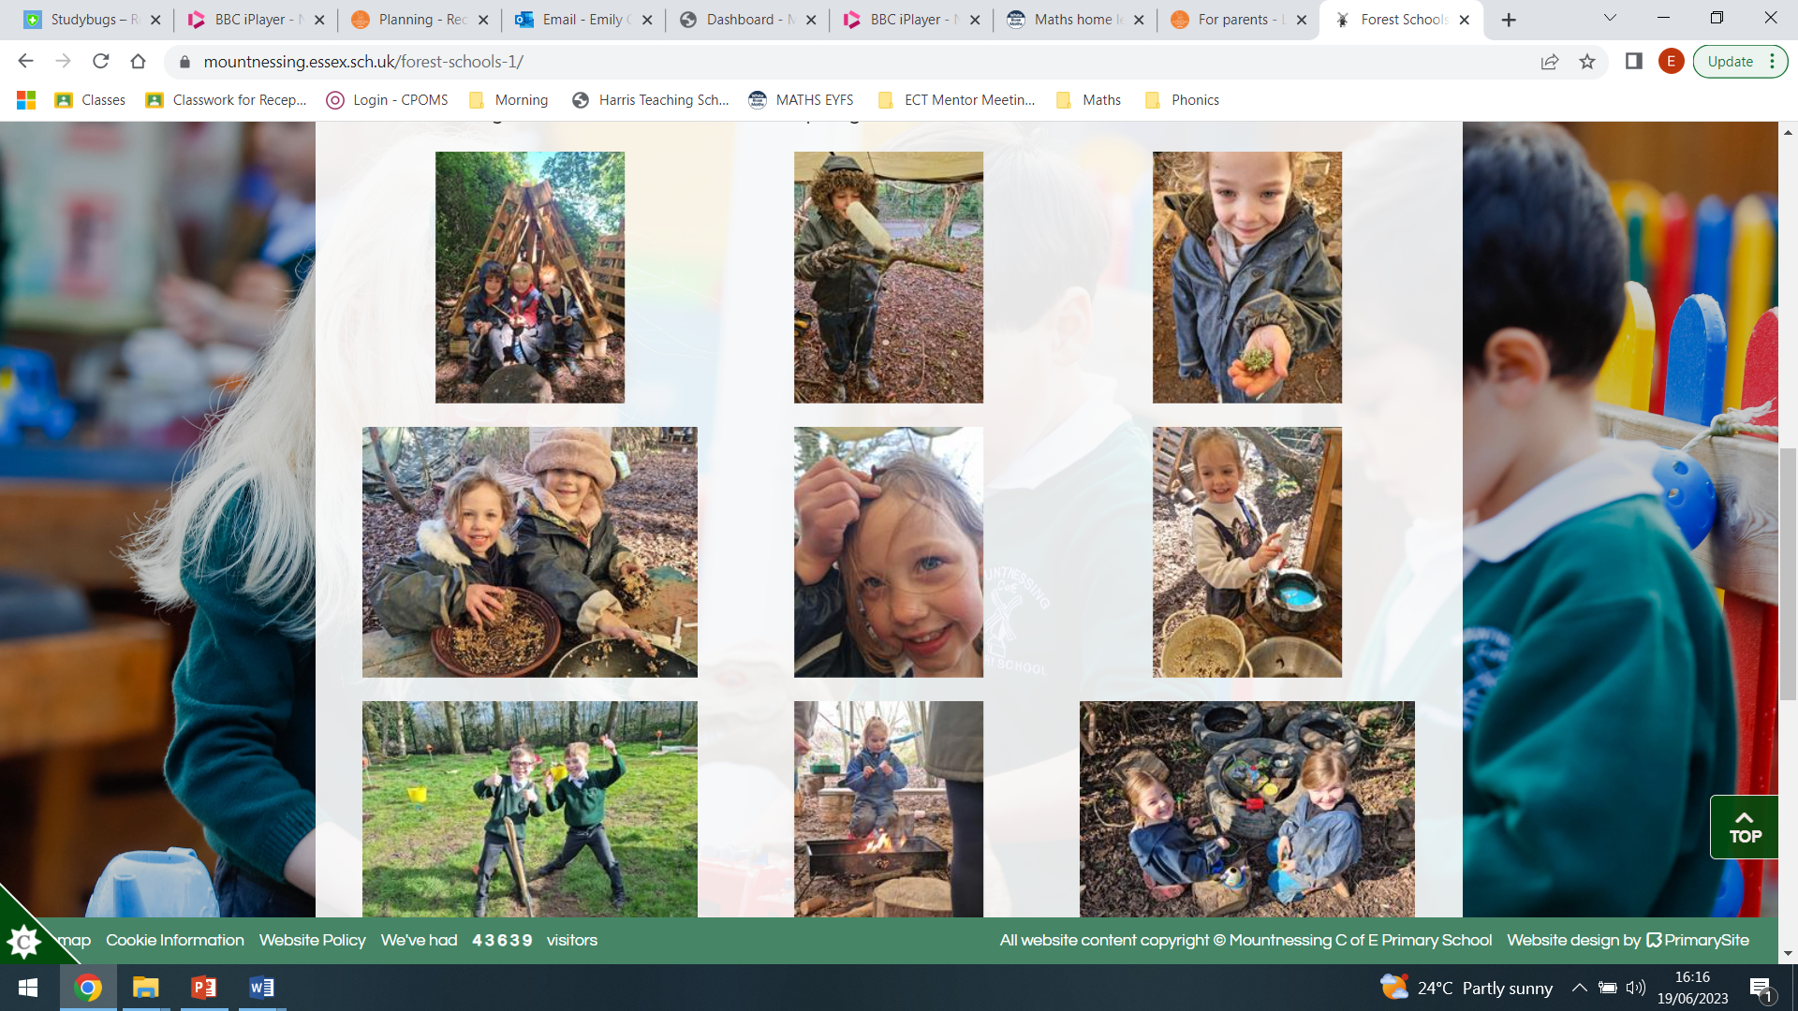
Forest School
The children will have the wonderful opportunity to take part in Forest School learning during their time at Mountnessing. They can build dens, make potions in the mud kitchen, toast marshmallows on the camp fire and learn how to explore and take risks safely. We have a qualified Forest School leader who will run these sessions.
You will be informed nearer the time when these sessions will take place.
On a forest school day the children will need to wear warm comfortable clothes and will be provided will overalls to kept them dry. Hats, scarves and gloves will be needed for cold weather and a pair of NAMED welly boots must be provided and will be kept at school.

Slide 20
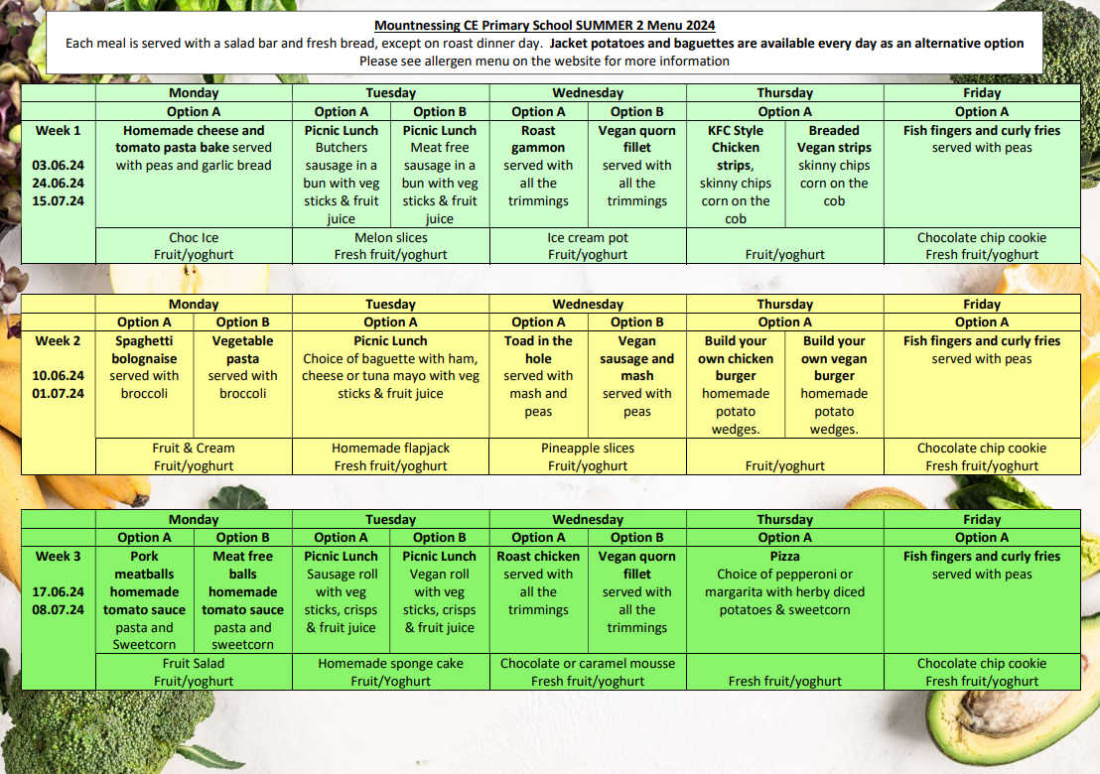
School meals are free for all EYFS & KS1 children.
The menu is available on our website and will be sent out via parent mail every half term. Please let the office know of any allergies your child may have before they start school in September.
We are a nut free school.

Slide 21
Transition dates:
Home visits will take place on either:
Monday 8th July
Tuesday 9th July
Friday 11th July
You will be given a date and time slot before you leave today.
Stay and play session in school is on Monday 14th or Tuesday 15th July 1.30 – 3.00pm.
Your child will given a morning or afternoon session for their transition into school in September - we gradually transition them into school life.

Slide 22
September 2025
In order to support your child to settle into school life smoothly, we implement a staggered start. This allows the children to learn our class rules and routines and meet new friends in smaller more focussed groups. We want all children to have a positive start to their school life so children with SEND may be offered an opportunity to have a longer induction period if needed.
Week 1: Week beginning Tuesday 2nd – Friday 5th September (4 days)
Half day sessions:
Morning sessions will run from 9.00 – 11.30am and afternoon sessions will run from 12.30 – 3.00pm.
Week 2: Week beginning Monday 8th September
Half days - morning and afternoon times continue as above.
Week 3 - Week beginning 15th September
Monday, Tuesday, Wednesday – The children will join together for lunch. Morning sessions will run from 9.00am – 12.30pm and afternoon sessions will run from 11.30am – 3.00pm.
Thursday & Friday – Full days at school. Children to arrive at 8.40am and be collected at 3.20pm.

Slide 23

Questions?

